Slide 3
Type
Sedan
Sedan
Police
SUV
SUV
Hatchback
Van
MiniVan
Van
Taxi
Bus
Truck including Truck Pickup, Truck Box Med, Truck Box Large, Truck Flatbed, and Truck Util

Slide 4
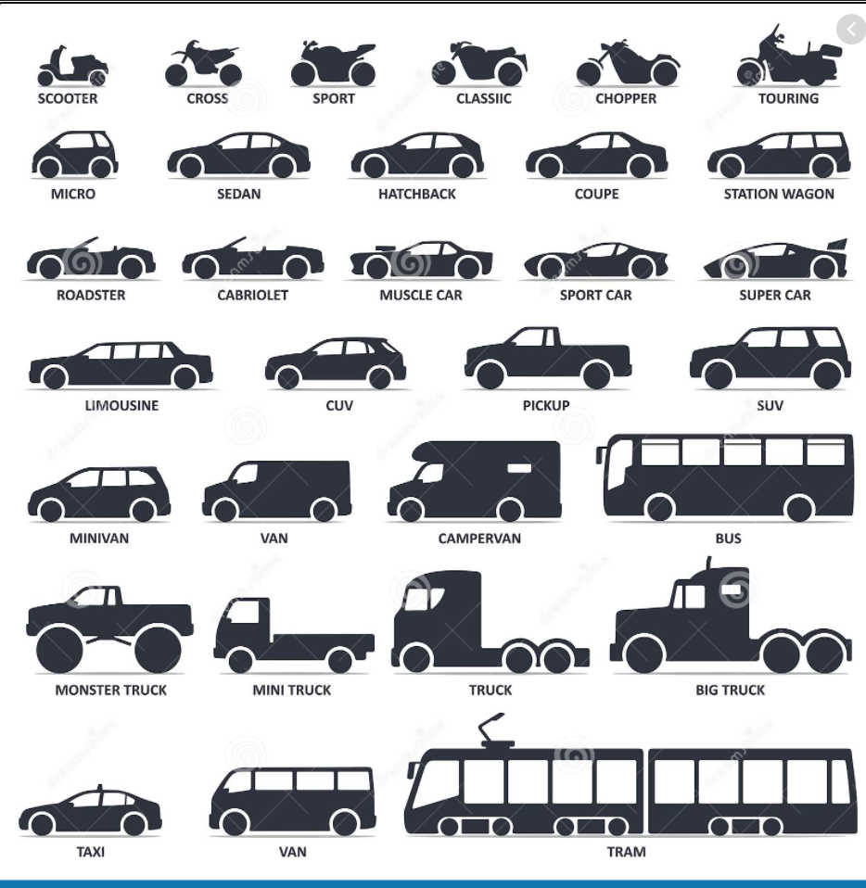

Slide 5
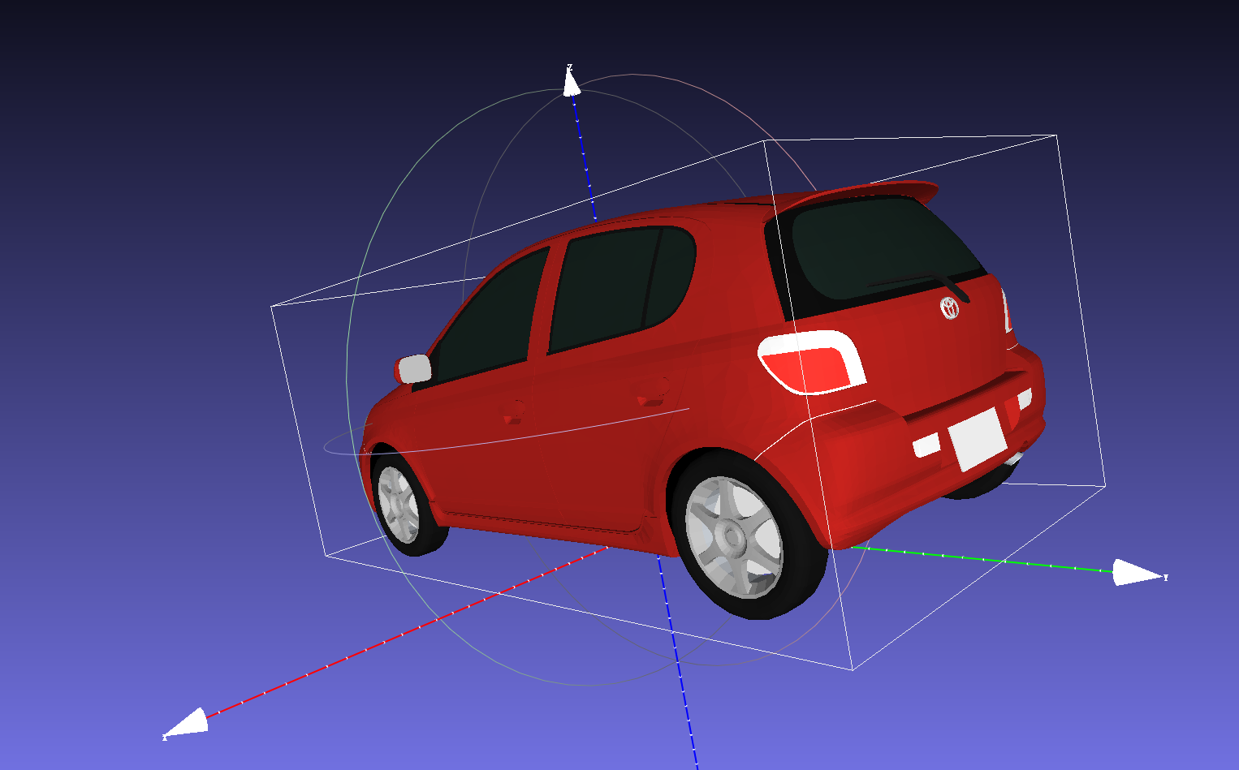

Slide 6
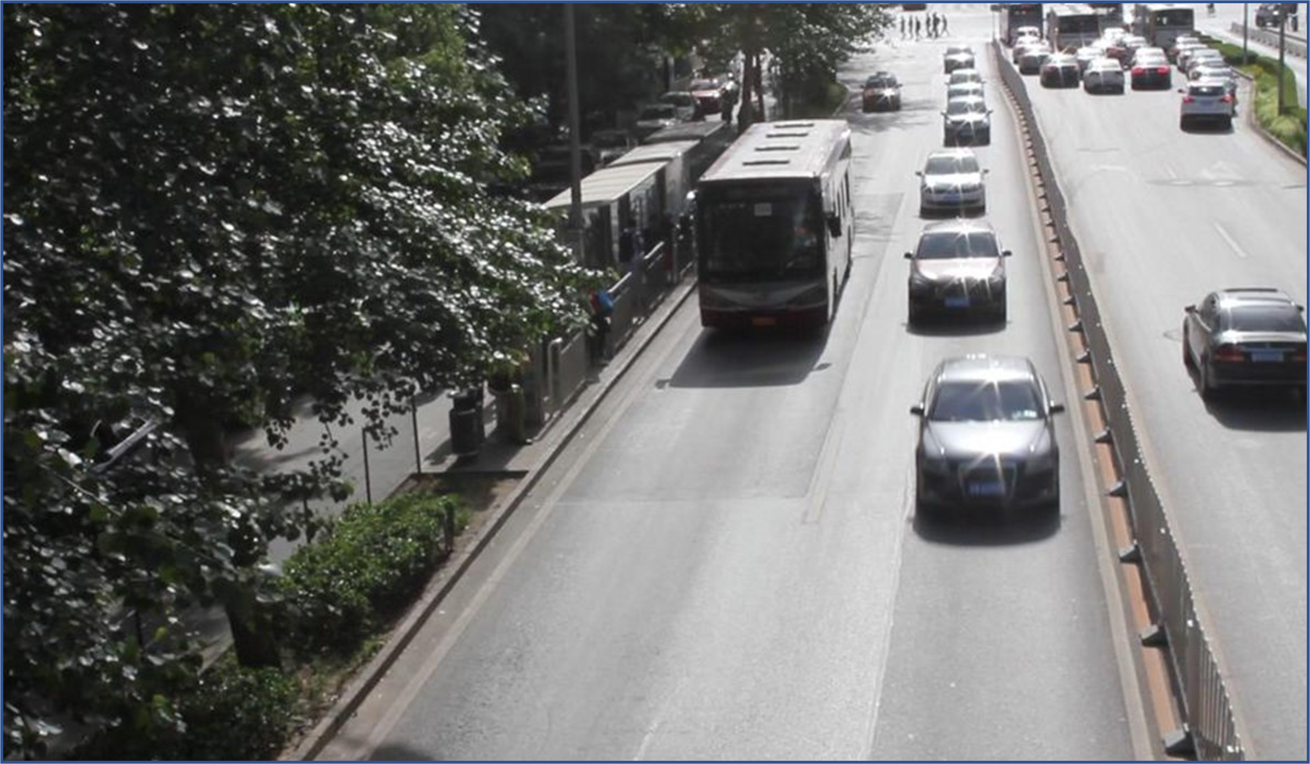

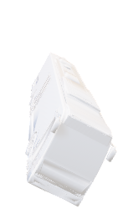
演示过程
$$w$$
$$h$$
Camera
CCD

Slide 7
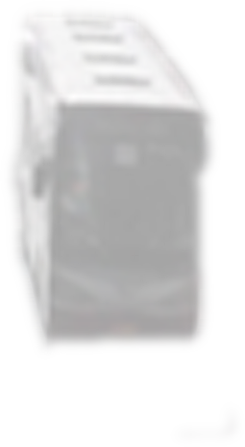
$$w$$
$$h$$
Camera
CCD
Real Vehicles
Primary projection diagram
Secondary projection diagram
Vehicle models
$$w$$
$$h$$
Camera
CCD

Slide 8
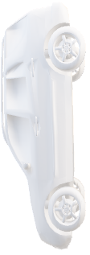

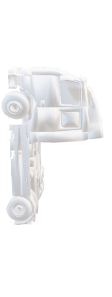
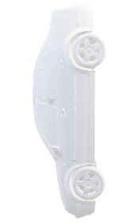

Type | Length | Width | Height | 3D Model
Car | 4.4 | 1.9 | 1.6
SUV | 5.2 | 2.1 | 1.9
Bus | 10.5 | 2.6 | 3.2
Truck | 5.8 | 3.0 | 3.3
VAN | 5.2 | 2.5 | 2.2

Slide 9

Type | Length | Width | Height | 3D Model
Car | 3.88 | 1.62 | 1.52
Bus | 16.09 | 2.54 | 3.52
Truck | 5.8 | 2.58 | 3.25
VAN | 5.07 | 1.90 | 2.2
Pedestrian | 1.0 | 0.4 | 1.8

